Slide 1
Rotation of a Rigid Object about a Fixed Axis

Slide 2
Rigid Object
The concepts introduced so far cannot be used to analyze all motion.
We can model the motion of an extended object by modeling it as a system of many particles.
  The analysis is simplified if the object is assumed to be a rigid object.
A rigid object is one that is non-deformable.
  The relative locations of all particles making up the object remain constant.
  All real objects are deformable to some extent, but the rigid object model is very useful in many situations where the deformation is negligible.
We will develop another class of concepts based on the rigid-object model

Slide 3
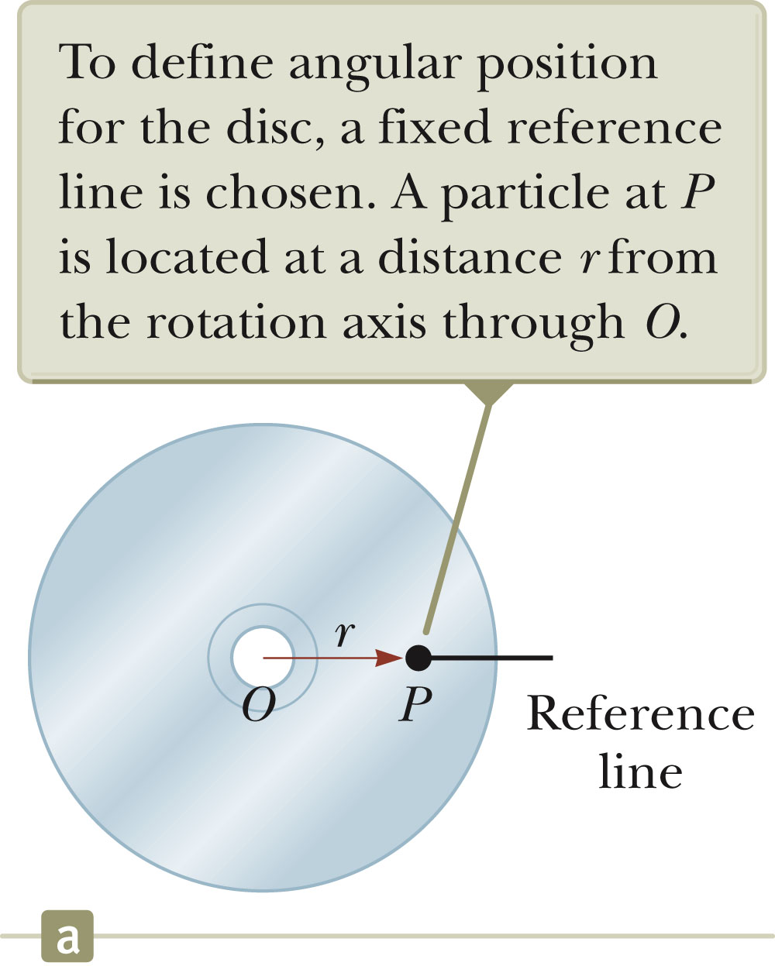
Angular Position
Axis of rotation is the center of the disc
Choose a fixed reference line.
Point P is at a fixed distance r from the origin.
  A small element of the disc can be modeled as a particle at P.
Polar coordinates are convenient to use to represent the position of P (or any other point).
P is located at (r, θ) where r is the distance from the origin to P and θ is the measured counterclockwise from the reference line.

Slide 4
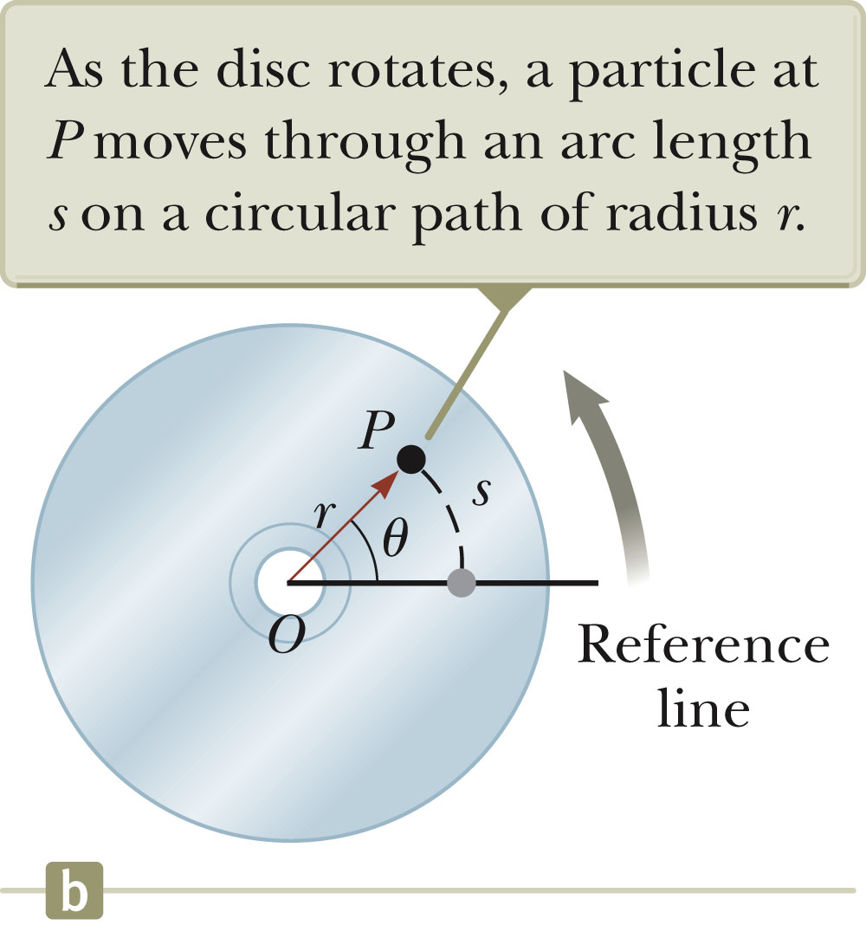
Angular Position, cont.
As the particle moves, the only coordinate that changes is θ.
As the particle moves through θ, it moves though an arc length s.
The arc length and r are related:
  s = θ r

Slide 5

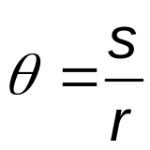
Radian
This can also be expressed as:
θ is a pure number, but commonly is given the artificial unit, radian.
One radian is the angle subtended by an arc length equal to the radius of the arc.
Whenever using rotational equations, you must use angles expressed in radians.

Slide 6
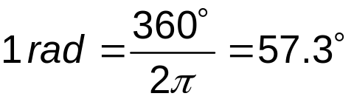
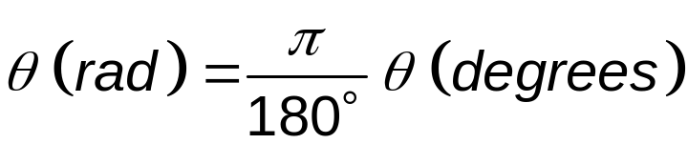
Conversions
Comparing degrees and radians
Converting from degrees to radians

Slide 7
Angular Position, final
We can associate the angle θ with the entire rigid object as well as with an individual particle.
  Remember every particle on the object rotates through the same angle.
The angular position of the rigid object is the angle θ between the reference line on the object and the fixed reference line in space.
  The fixed reference line in space is often the x-axis.
The angle θ plays the same role in rotational motion that the position x does in translational motion.

Slide 8
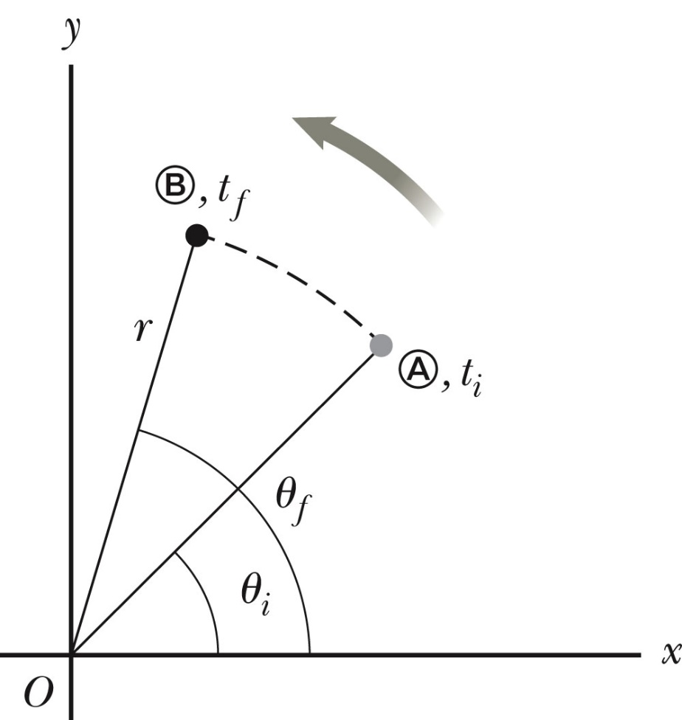
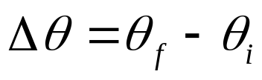
Angular Displacement
The angular displacement is defined as the angle the object rotates through during some time interval.
This is the angle that the reference line of length r sweeps out.

Slide 9
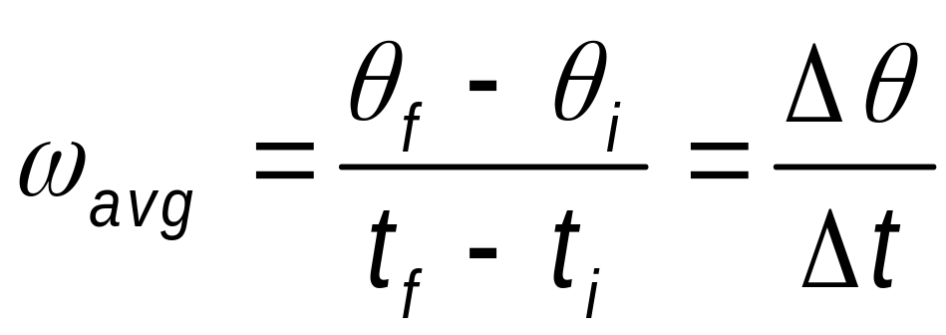
Average Angular Speed
The average angular speed, ω_{avg}, of a rotating rigid object is the ratio of the angular displacement to the time interval.

Slide 10
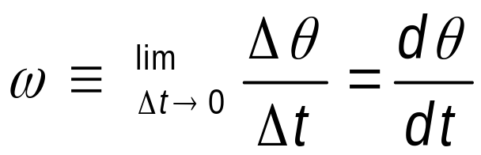
Angular Speed (or Instantaneous Angular Speed)
The instantaneous angular speed is defined as the limit of the average speed as the time interval approaches zero.
This is analogous to translational speed.
Units of angular speed are radians/sec.
  rad/s or s⁻¹ since radians have no dimensions.
Angular speed will be positive if θ is increasing (counterclockwise)
Angular speed will be negative if θ is decreasing (clockwise)

Slide 11
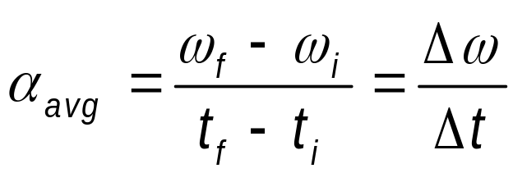
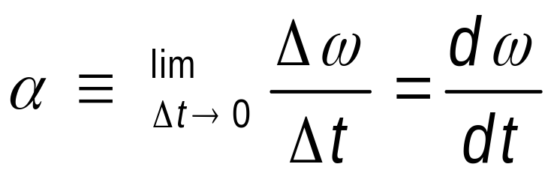
Angular Acceleration
The average angular acceleration, α _{avg}, of an object is defined as the ratio of the change in the angular speed to the time it takes for the object to undergo the change.
The instantaneous angular acceleration is defined as the limit of the average angular acceleration as the time goes to 0.

Slide 12
Angular Acceleration, cont.
Analogous to translational acceleration
Units of angular acceleration are rad/s² or s⁻² since radians have no dimensions.
Angular acceleration will be positive if an object rotating counterclockwise is speeding up.
Angular acceleration will also be positive if an object rotating clockwise is slowing down.

Slide 13
Angular Motion, General Notes
When a rigid object rotates about a fixed axis in a given time interval, every portion on the object rotates through the same angle in a given time interval and has the same angular speed and the same angular acceleration.
  So θ, ω, α all characterize the motion of the entire rigid object as well as the individual particles in the object.

Slide 14
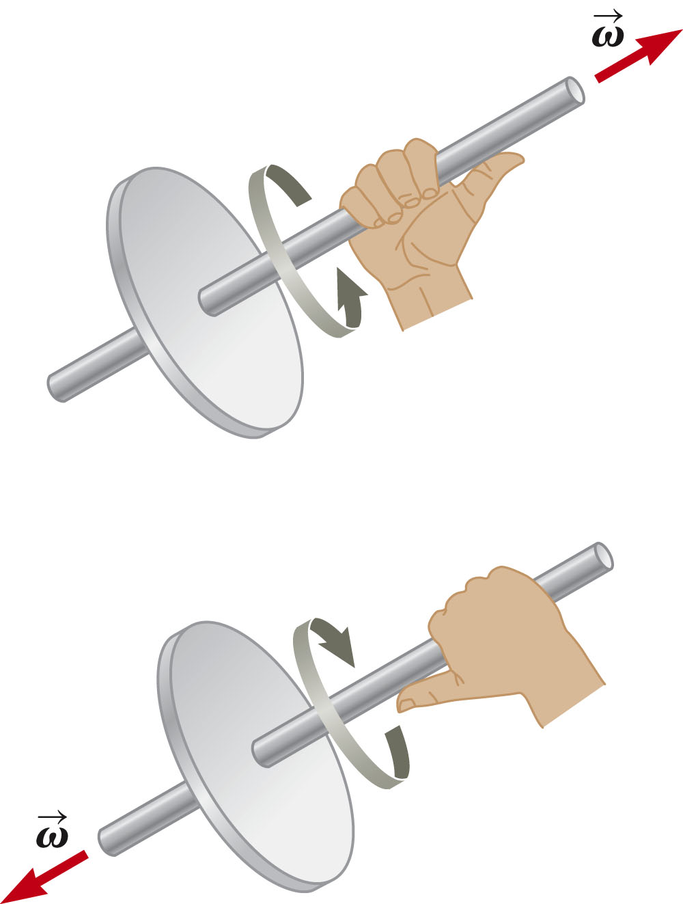
Directions, details
Strictly speaking, the speed and acceleration (ω, α) are the magnitudes of the velocity and acceleration vectors.
The directions are actually given by the right-hand rule.

Slide 15
Rotational Kinematics
Under constant angular acceleration, we can describe the motion of the rigid object using a set of kinematic equations.
  These are similar to the kinematic equations for linear motion.
  The rotational equations have the same mathematical form as the linear equations.
The new model is a rigid object under constant angular acceleration.
  Analogous to the particle under constant acceleration model.

Slide 16
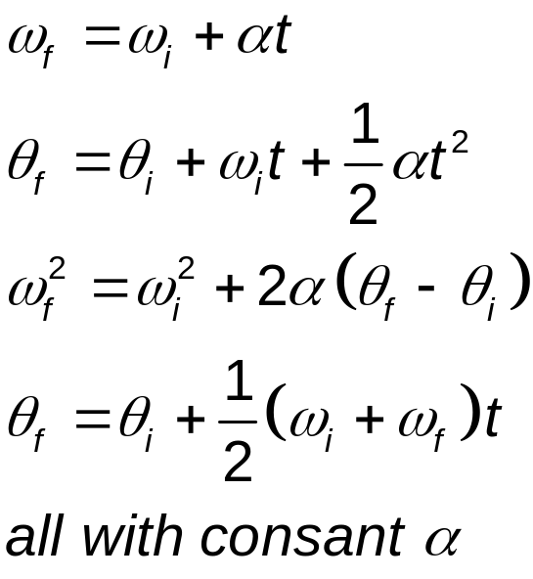
Rotational Kinematic Equations
The kinematic expression for the rigid object under constant angular acceleration are of the same mathematical form as those for a particle under constant acceleration.
Substitutions from translational to rotational are
  x → θ
  v → ω
  a → α

Slide 17
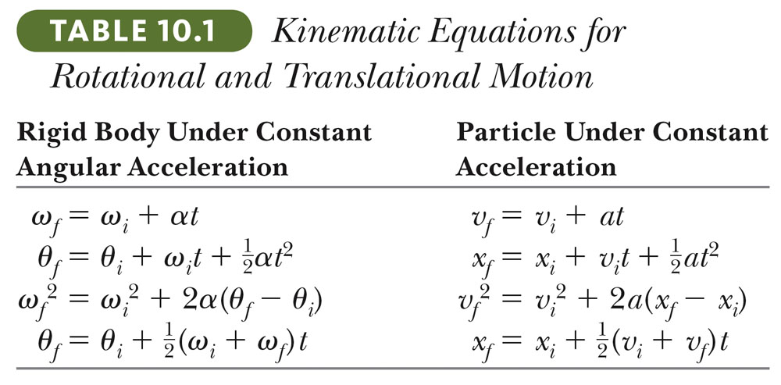
Comparison Between Rotational and Linear Equations

Slide 18
Relationship Between Angular and Linear Quantities
Every point on the rotating object has the same angular motion.
Every point on the rotating object does not have the same linear motion.
Displacements
  s = θ r
Speeds
  v = ω r
Accelerations
  a = α r

Slide 19
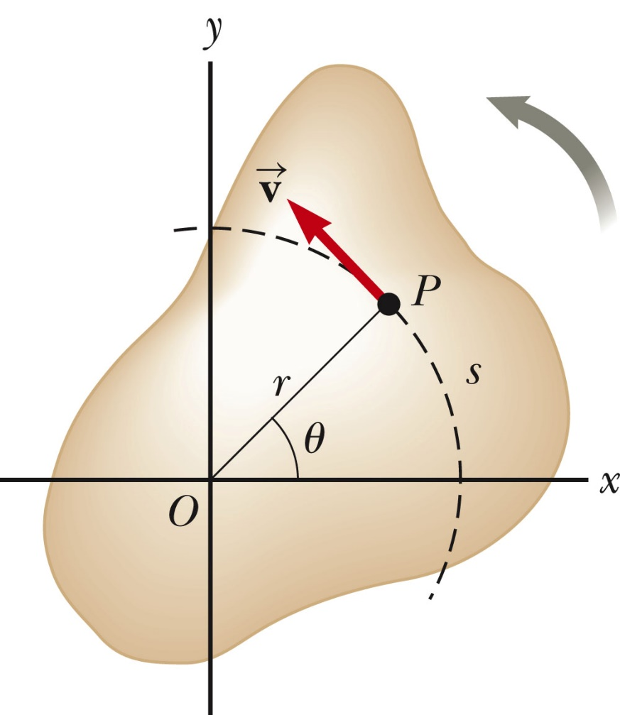
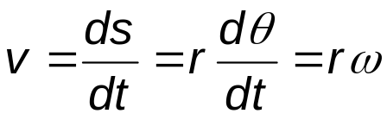
Speed Comparison – Details
The linear velocity is always tangent to the circular path.
  Called the tangential velocity
The magnitude is defined by the tangential speed.
Since r is not the same for all points on the object, the tangential speed of every point is not the same.
The tangential speed increases as one moves outward from the center of rotation.

Slide 20
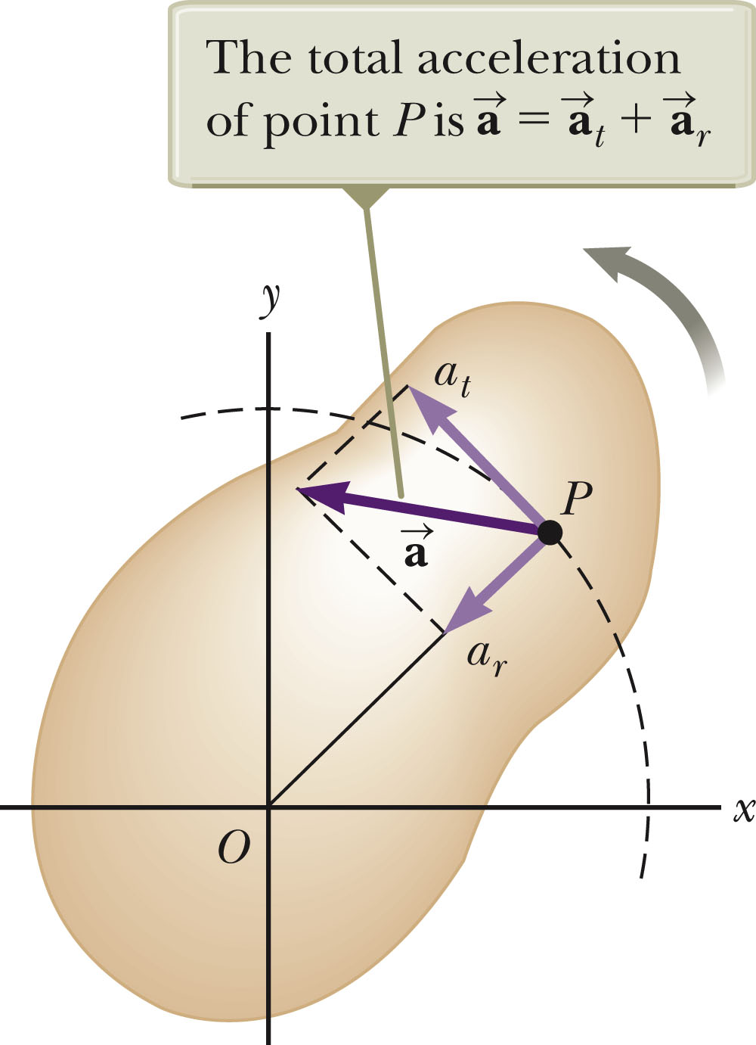
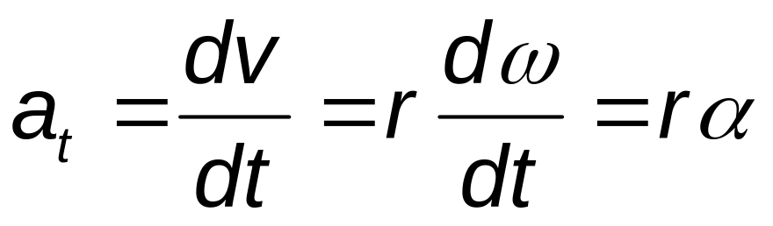
Acceleration Comparison – Details
The tangential acceleration is the derivative of the tangential velocity.

Slide 21
Speed and Acceleration Note
All points on the rigid object will have the same angular speed, but not the same tangential speed.
All points on the rigid object will have the same angular acceleration, but not the same tangential acceleration.
The tangential quantities depend on r, and r is not the same for all points on the object.

Slide 22
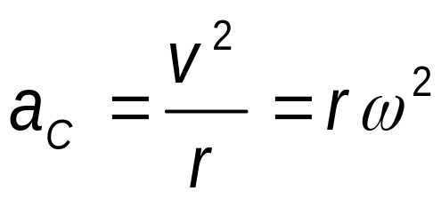
Centripetal Acceleration
An object traveling in a circle, even though it moves with a constant speed, will have an acceleration.
  Therefore, each point on a rotating rigid object will experience a centripetal acceleration.

Slide 23

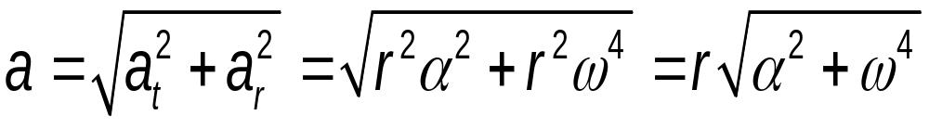
Resultant Acceleration
The tangential component of the acceleration is due to changing speed.
The centripetal component of the acceleration is due to changing direction.
Total acceleration can be found from these components:

Slide 24
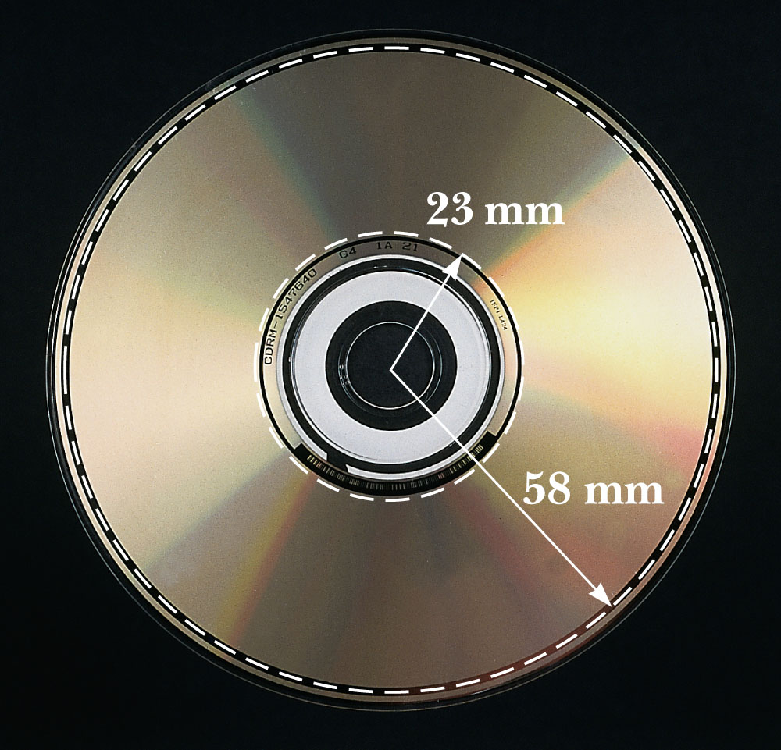
Rotational Motion Example
For a compact disc player to read a CD, the angular speed must vary to keep the tangential speed constant (v_{t} = ωr).
  Typically the constant speed of the surface at the point of the laser-lens system is 1.3 m/s.
At the inner sections, the angular speed is faster than at the outer sections.

Slide 25
Torque
Torque, τ, is the tendency of a force to rotate an object about some axis.
  Torque is a vector, but we will deal with its magnitude here:
  τ = r F sin φ = F d
    F is the force
    φ is the angle the force makes with the horizontal
    d is the moment arm (or lever arm) of the force
  There is no unique value of the torque on an object.
    Its value depends on the choice of a rotational axis.

Slide 26
Torque vs. Force
Forces can cause a change in translational motion.
  Described by Newton’s Second Law
Forces can cause a change in rotational motion.
  The effectiveness of this change depends on the force and the moment arm.
  The change in rotational motion depends on the torque.

Slide 27
Torque Units
The SI units of torque are N.m.
  Although torque is a force multiplied by a distance, it is very different from work and energy.
  The units for torque are reported in N.m and not changed to Joules.

Slide 28
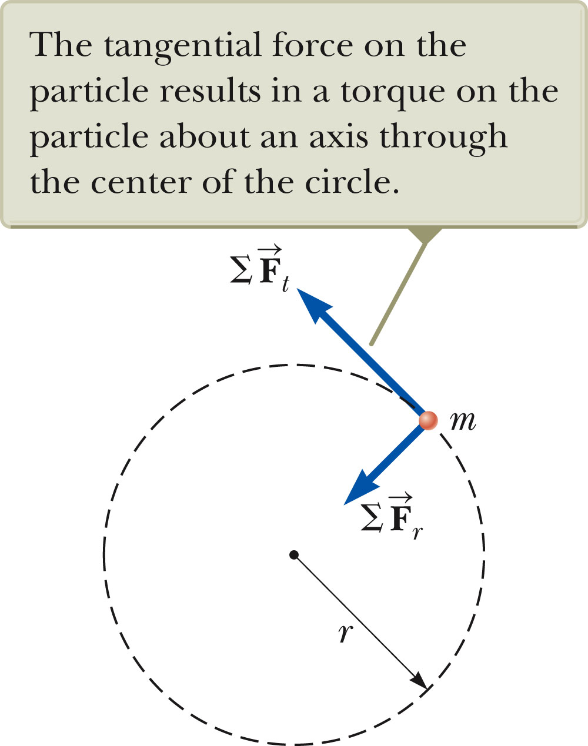
Torque and Angular Acceleration
Consider a particle of mass m rotating in a circle of radius r under the influence of tangential force .
The tangential force provides a tangential acceleration:
  F_{t} = ma_{t}
The radial force F_{r} causes the particle to move in a circular path.

